Slide 1
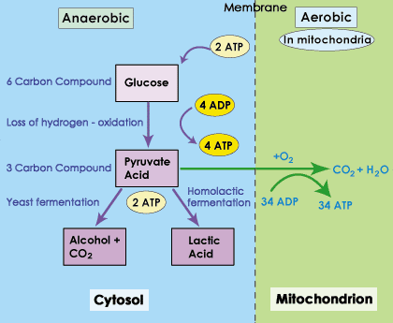
Aerobic and Anaerobic Respiration
By: Mr. Raymond Luong

Slide 2
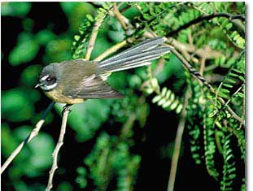
Aerobic Cellular Respiration
All plants and animals need oxygen to survive
Cells use oxygen to obtain energy from food: aerobic cellular respiration

Slide 3
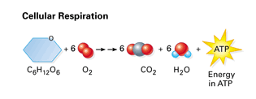
Aerobic Cellular Respiration
Glucose reacts with oxygen to form carbon dioxide, water and energy (ATP)
C₆H₁₂O₆ + 6O₂ → 6CO₂ + 6H₂O + energy (ATP)
For one molecule of glucose, 36 molecules of ATP are formed

Slide 4
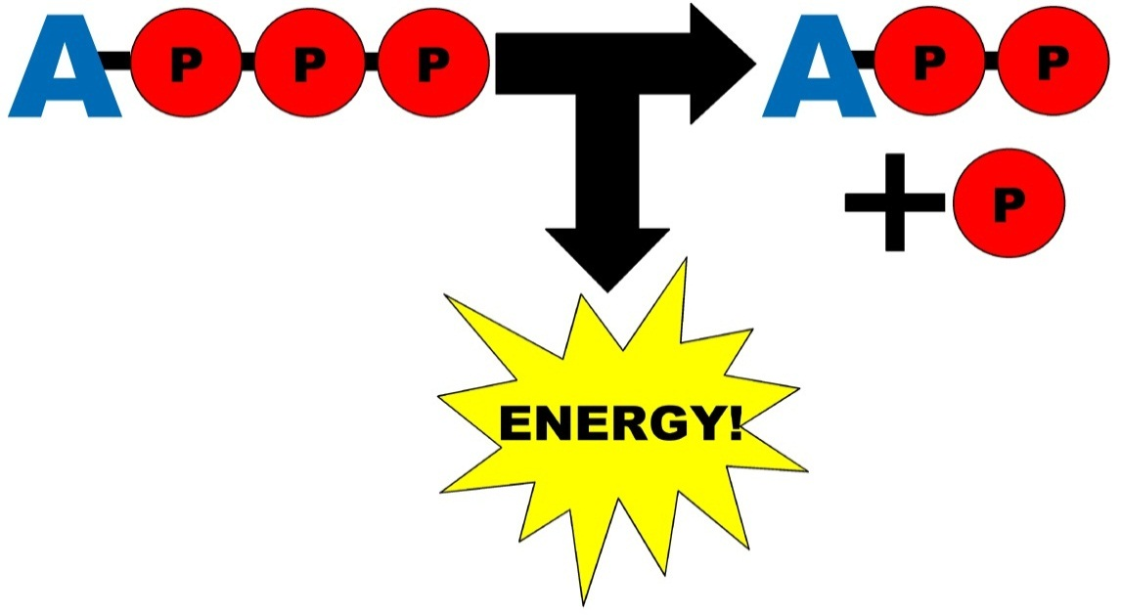
Aerobic Cellular Respiration
Cells use ATP to for growth, movement and building new molecules
ATP reacts with other molecules, releasing energy and reforming ADP

Slide 6
 | Aerobic Respiration | Anaerobic Respiration
Oxygen requirement: | Yes | No
Site of reactions: | Cytoplasm and mitochondria | Cytoplasm
Stages: | Glycolysis, Krebs cycle, Electron Transport Chain | Glycolysis, Fermentation
Net Production of ATP: | 38 ATP per 1 glucose | 2 ATP per 1 glucose
Conversion of Pyruvate: | Carbon Dioxide | Lactic Acid or Alcohol
How it recycles NADH: | Electron Transport Chain | Fermentation
Cells that use: | most cells | yeast, prokaryotes, muscle cells
Production of lactic acid: | Does not produce lactic acid | Produces lactic acid

